Slide 1
Minimum Requirements Analysis
Note to presenters -
This file is part of the FS Resources section at: http://www.wilderness.net/fs/
This presentation should be reviewed and revised as needed to match the training objectives and target audience and to insert local images as needed
The Minimum Requirements Analysis training presentations are posted in 6 parts which may be combined and used as needed:
  Introduction
  Basis in Law and Policy
  Definitions
  Minimum Requirements process
    Step 1
    Step 2
  Use of the MRA process
  Use of Traditional Skills and Tools

Slide 2
Traditional Tools and Skills
- Safety, Cost, Resource Impacts, and Training -
Notes to presenter:
These training materials are intended to help facilitate a discussion of the use of traditional skills and tools vs. motorized equipment, mechanical transport, aircraft, etc.
The data cited comes from an informal study of safety records for backcountry trail work in Regions 1, 2, and 6 for the 2001-2004 period.
Examples are based on communications with local managers and others who participated in the projects.
Local examples, images, and data may be added to tailor the presentation to fit the intended audience.
Both a short and long version of the Minimum Requirements Analysis and Decision Guide process presentations are available.

Slide 3

Minimum Requirements Analysis
Use of Traditional Tools and Skills
- Safety, Cost, Resource Impacts and Training -

Slide 4
Use of Motorized Tools vs. Traditional Skills
- What’s the problem ? -
1. Increasing use of motorized tools means:
loss of traditional skills
lack of contrast between wilderness and other public lands
2. External influences to ‘get the work done’ because:
Public and commercial access to public lands
Law and policy seen as barrier
3. Internal pressure to meet objectives
Some justification for pre-determined use of motorized equipment based on assumptions

Slide 5
Use of motorized tools vs. Traditional Skills
- What’s the problem ? -
Limited funding
Reduced staffing
Lack of traditional tools and skills
Need to get the project done; public access
vs.
Intent of law and policy
Traditional skill retention
Public awareness of wilderness and appreciation of traditional skills

Slide 6
Traditional Tools vs. Motorized Equipment
- Assumptions and Facts -
Assumptions about traditional tools:
Less safe
More expensive
Less efficient
More resource impacts
Difficult to learn
Skills or tools not available

Slide 7
Non-motorized tools are less safe ?
Chainsaw vs. cross-cut saw
Chain saw accident rate per hour of use is 18-20 times higher
Severity of injury with chainsaw is 120 times more severe
Rock drill vs. hand drill
Hand drill accidents = 0
Motorized rock drill accidents = 7
FS Data for 2001 – 2004 from Regions 1,2, and 6
Notes:
Recent data from FS safety records for the Northern, Rocky Mtn, and Pacific Northwest Regions:
2001 – 2004
Accidents with chainsaws = 49, Accidents using cross-cut saw = 3
Accidents with power rock drills = 7,Accidents with hand drilling = 1

Slide 8
Non-motorized tools are more expensive ?
Consider the true costs:
Insurance rates for trail maintenance contracts
- Chainsaw $7.20/hr.
- Cross-cut saw $1.70/hr.
Tool costs
- helicopter time vs. pack stock use
- chainsaw vs. cross-cut saw
- rock drill vs. hand drill
Notes:
In the real world the insurance industry calculates the rates based on the probability of an accident and the resulting costs.
For most projects, approval to use motorized equipment requires an analysis and approval process that can be time consuming.
The cost of procuring motorized equipment is far higher than for non-motorized tools.

Slide 9
Non-motorized tools are more time consuming ?
Consider all aspects of the project:
Example – trail clearing
Actual hours of saw cutting (tool use) vs.
travel, camping, swamping brush
Staff time for analysis and approval of motorized equipment use
Down-time for accidents
Notes:
The work required for most projects entails lots more than just the actual use of the tool. For example, clearing fallen trees from a trail requires a little saw time but the majority of crew time is spent traveling to the project site and moving the cut logs and limbs (swamping). The travel and swamping time will be about the same for each method. There may be some efficiency in saw time but the amount of saw time is a low percentage of the overall project time.

Slide 10
Non-motorized tools cause more resource impacts ?
Crew camps in wilderness
- Practice Leave No Trace, use established sites
Multiple trips on trails using pack stock
- Resolve existing trail condition issues
- Inform and educate visitors to address issues ?
Visitor created impacts (i.e. new trails around fallen trees)
- Consider option to temporarily close affected area
Commercial use (outfitter-guides) business impairment
- Temporarily relocate operations
Notes:
It is often assumed that use of non-motorized tools will require more time in camp, more travel on trails, result in increased wilderness resource impacts or be an unnecessary burden on commercial services providers. This does not have to be the case. Consider:
1) As discussed in the previous trail clearing example, the total amount of project time is not totally dependent on the tool used.
2) Crews should be using existing campsites and following Leave No Trace practices at all times to minimize impacts.
3) If trails are impacted by multiple trips with pack stock to move materials and crews in and out won’t they be impacted by normal visitor use also? If the trail is open for stock use, trail maintenance practices may need to be adjusted to mitigate resource impacts that likely would occur anyhow through normal use and the project can be scheduled to occur during the dry season to reduce effects.
4) In the trail clearing example, if the trail remains open while work is in progress, visitors may create new routes by going around areas that are not yet cleared. Resource impact problems can often be solved through temporary trail closures.
5) Commercial services (outfitter-guides) may be affected by trails that are not open due to fallen trees or closures, just as they are during fire events. Effects can often be mitigated by temporarily relocating providers to non-affected areas.

Slide 11
Non-motorized tools are more difficult to learn ?
Consider using skilled detailers to do project and train and certify local crews and partners in traditional skills while working
Both motorized and non-motorized tools require training and certification
Notes:
Primitive and traditional tool use skills can be learned and many resources exist to help with training needs.
Detailers can often do training while a work project is being accomplished.
Use of both motorized and non-motorized tools require training and certification

Slide 12
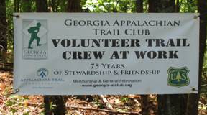


Non-motorized tools are more difficult to learn ?
Volunteers can be trained and certified and volunteers are trainers
Notes:
Primitive and traditional tool use skills can be learned and many resources exist to help with training needs.
1) Volunteers can do it! Volunteer organizations offer training as agency cooperators that meets agency requirements.
2) Training can often be done while a work project is being accomplished.

Slide 13
Non-motorized tools are more difficult to learn ?
Intellectual challenge
- Problem solving and team work
vs.
- Power tool use and routine work
Notes:
The use of primitive/traditional skills and tools requires problem solving and team work to be effective and efficient. The use of power tools is often more routine and can be less about team work and often leads to unnecessary cutting, drilling, or work because of the nature of power tool use. Learning and using problem solving skills ultimately more empowering and leads to more efficient, safe work.

Slide 14
Training Not available ?
Ninemile Wildlands Training Center www.fs.fed.us/r1/lolo/resources-cultural/nwtc/
Volunteer/Partner group training programs See the Volunteers and Partners Toolbox
www.wilderness.net/toolboxes/
Notes:
1) Agencies provide training and some require certification some tools (i.e. cross-cut saw). Trainers can be found in all agencies and regions or states.
2) The Ninemile Wildland Training Center (located outside Missoula, MT) provides training on the use of non-motorized tools and packstock foragency employees and volunteers. See: www. __
3)Volunteers for Outdoor Colorado, Stanislaus Wilderness Volunteers, Student Conservation Association, etc. see the Volunteers and Partners Toolbox at: www.wilderness.net/toolboxes/.
4) A common solution to lack of skills is to bring in a qualified detailer to help accomplish the project and also train local crews and/or volunteers. See your agency rep. for contact information.
5) Tools can be purchased, borrowed, and maintained. The Primitive/Traditional Skills Toolbox contains more information at: www.wilderness.net/toolboxes/.
6) The use of tools on public lands is supported by testing and development work performed by the Missoula Technology Development Center. Access publications and on-line resources at: www. ______

Slide 15
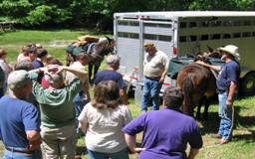
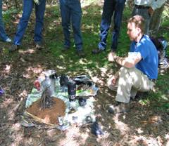
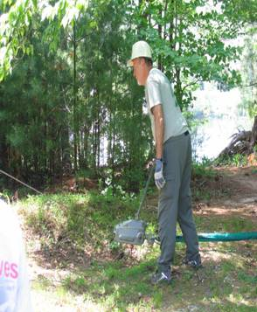
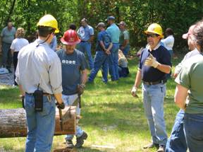
Training Not available ?
Regions/forests provide and require training and certification for employees, contractors, and volunteers
Notes:
1) Agencies provide training and some require certification some tools (i.e. cross-cut saw). Trainers can be found in all agencies and regions or states.
2) The Ninemile Wildland Training Center (located outside Missoula, MT) provides training on the use of non-motorized tools and packstock for agency employees and volunteers. See: www. __
3)Volunteers for Outdoor Colorado, Stanislaus Wilderness Volunteers, Student Conservation Association, etc. see the Volunteers and Partners Toolbox at: www.wilderness.net/toolboxes/.
4) A common solution to lack of skills is to bring in a qualified detailer to help accomplish the project and also train local crews and/or volunteers. See your agency rep. for contact information.
5) Tools can be purchased, borrowed, and maintained. The Primitive/Traditional Skills Toolbox contains more information at: www.wilderness.net/toolboxes/.
6) The use of tools on public lands is supported by testing and development work performed by the Missoula Technology Development Center. Access publications and on-line resources at: www. ______

Slide 16
Tools Not available ?
Information and resources are available:
Missoula Technology Development Center Resources for tools and equipment
http://fsweb.mtdc.wo.fs.fed.us/programs/rec/index.htm
Traditional Tools and Skills Toolbox
http://www.wilderness.net/toolboxes/
Notes:
1) Agencies provide training and some require certification some tools (i.e. cross-cut saw). Trainers can be found in all agencies and regions or states.
2) The Ninemile Wildland Training Center (located outside Missoula, MT) provides training on the use of non-motorized tools and packstock for agency employees and volunteers. See: www. __
3)Volunteers for Outdoor Colorado, Stanislaus Wilderness Volunteers, Student Conservation Association, etc. see the Volunteers and Partners Toolbox at: www.wilderness.net/toolboxes/.
4) A common solution to lack of skills is to bring in a qualified detailer to help accomplish the project and also train local crews and/or volunteers. See your agency rep. for contact information.
5) Tools can be purchased, borrowed, and maintained. The Primitive/Traditional Skills Toolbox contains more information at: www.wilderness.net/toolboxes/.
6) The use of tools on public lands is supported by testing and development work performed by the Missoula Technology Development Center. Access publications and on-line resources at: http://fsweb.mtdc.wo.fs.fed.us/programs/rec/index.htm

Slide 17
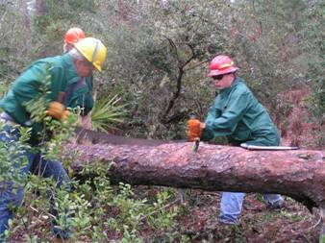
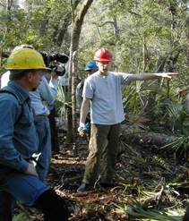
Still not convinced ?
-Examples -
Hurricane – Juniper Prairie Wilderness, FL, 2004-2005
- Rigging, winching, and log moving skills needed
- Work included cutting and moving logs to re-open canoe trail
- Some logs underwater
Notes:
Source: Ian Barlow and Susan Jenkins, Nez Perce NF and local wilderness contacts.

Slide 18
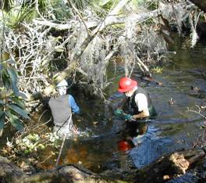
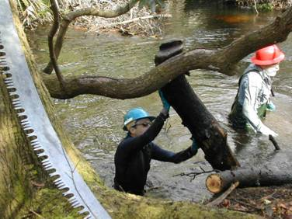
Still not convinced ?
-Examples -
Hurricane – Juniper Prairie Wilderness, FL, 2004-2005
- Detailers from out of region during winter
Local crews and volunteers trained by detailers while clearing trail
Florida Trail Association now utilizes non-motorized tools outside wilderness
Traditional skills and tools part of heritage and source of pride.
Notes:
Source: Ian Barlow and Susan Jenkins, Nez Perce NF and local wilderness contacts.

Slide 19
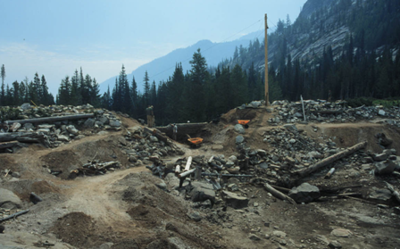
Still not convinced ?
-Examples -
Selway-Bitteroot Wilderness, MT - 2003
- Partial breach of Canyon Lake dam
- Non-motorized work project cost $ 375,000 less than motorized equipment alternative
- Accomplished with help from
the Montana
Conservation
Corps
Notes:
Source: Ian Barlow and Susan Jenkins, Nez Perce NF and local wilderness contacts.

Slide 20
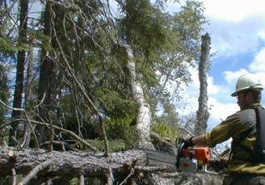
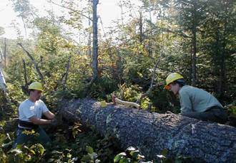
Still not convinced ? -Examples -
Boundary Waters Canoe Area Wilderness, MN 175,000 acres of blowdown trees, July 4, 2000
Chainsaws used to evacuate visitors, then most work done with cross-cut saws
2 crews, chainsaw vs. cross-cut saw, up to 1000 trees per mile
after 38 hours of ‘saw time’ (17 days or work) amount of trail cleared by each crew within 100 feet
- chain saw work area had more ‘modified’ look despite identical project standards
Notes:
Source: Ian Barlow and Susan Jenkins, Nez Perce NF and BWCAW wilderness managers.

Slide 21
Conclusion
Assumptions and Facts for Non-motorized Tools
Non-motorized tools can be found
Traditional skills can be taught/learned
Skilled help can be found
Partnerships and can be built/enhanced
The wilderness resource can be protected
Cost effective projects are possible
Safety requirements can be met

Slide 22
Use of Motorized Tools vs. Traditional Skills
- What’s the problem ? -
Budget, staff, time
Other targets and priorities
Public pressure to keep public lands open
Assumptions about cost, safety, skills needed
vs.
Mandate of law and intent of policy
– primarily non-motorized management
- in contrast to other areas
Traditional skill retention through training and partnerships
Public awareness of wilderness and appreciation of traditional skills and heritage

Slide 23
The Bottom Line
-We can do it !!!-
Your time and commitment to wilderness is both required and appreciated
Adopt a ‘wilderness ethic’ – a perspective that recognizes the unique resource of wilderness and how work can be done
Assess projects and make decisions without false assumptions
Train and work safely
For more information visit the Traditional Tools and Skills Toolbox at www.wilderness.net/toolboxes/

Slide 24
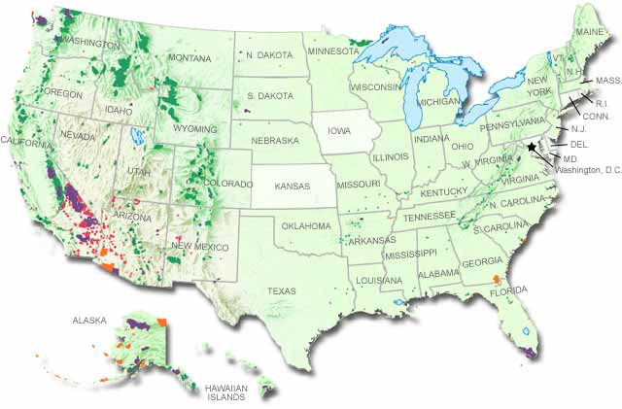
Wilderness
‘for the permanent good of the whole people, and for other purposes’
Notes:
End slide

